Slide 1
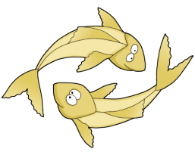
Welcome

Slide 2
Introduction
Class-One
Subject-English
Unit-4;Let’s count
Lesson – 3; Rhyme
“One two three four five”
Time-45 minutes
Mahfuz Ara Sultana
Assistant teacher
Carmichael College Government primary school.
Rangpur city.

Slide 3
Learning Outcomes
Student will be able to
read the text and recite the rhyme with correct pronunciation.

Slide 4

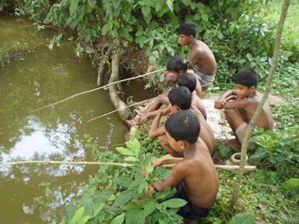
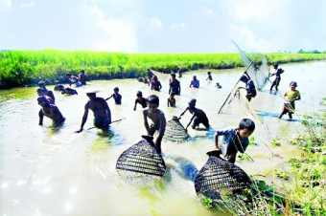
Creating emotion
What are they doing?
Have you ever gone to fishing?
How many fishes have you caught?

Slide 5

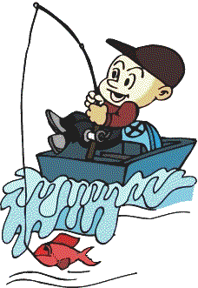
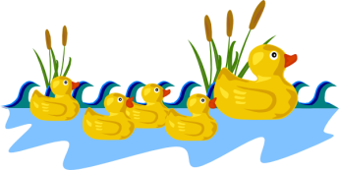
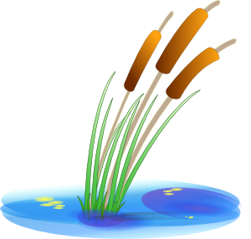




Is fishing enjoyable?
Do you want to hear a fishing song?
Let’s see the video.

Slide 6
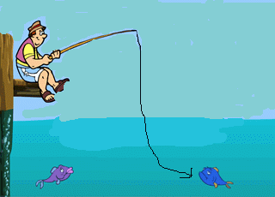
Now we read the rhyme.
One
Two
Three
Four
Five

Slide 7
Input
Students repeat the rhyme after teacher.

Slide 8
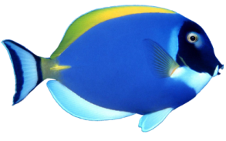

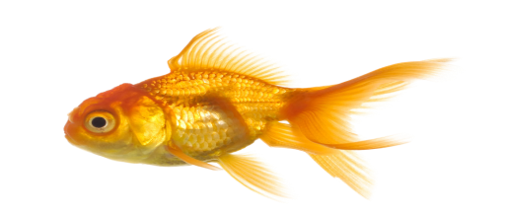
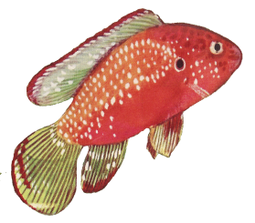
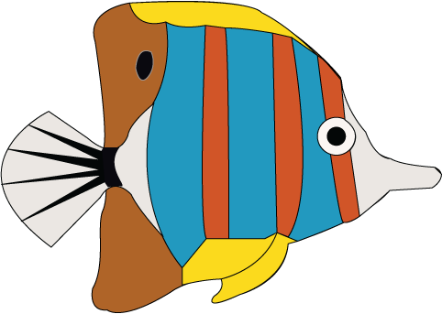
four
three
One
five
two

Slide 9

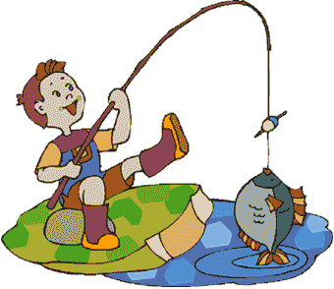
Once I caught a fish alive.

Slide 10
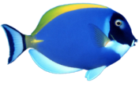



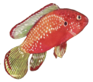
nine
eight
seven
ten
six

Slide 11

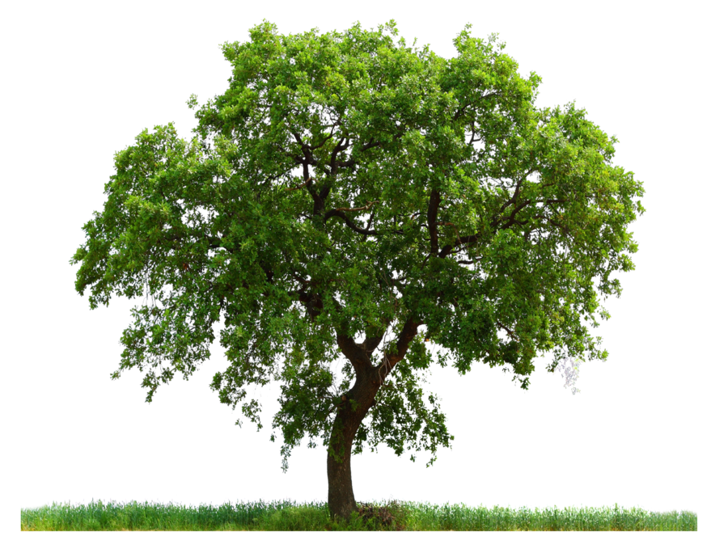

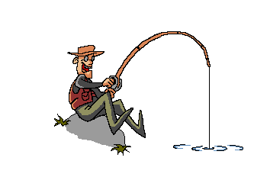
Then I let it go again.

Slide 12
Practice
Open your book ( page no: 44 )

Slide 13
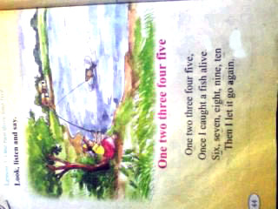
Compare lines with your text book.
One two three four five,
Once I caught a fish alive.
Six seven eight nine ten,
Then I let it go again.

Slide 14
Group Work
  Recite the rhyme in chain drill
Group
One two three four five
Group
Once I caught a fish alive.
Group
Six seven eight nine ten
Group
Then I let it go again.

Slide 15
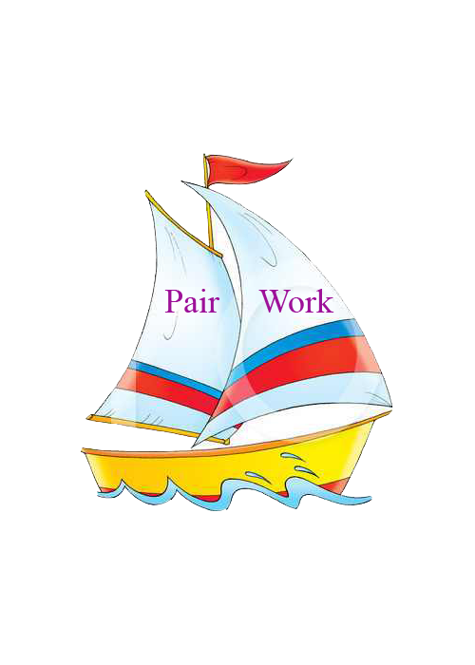
Say the next line in pair
One two three four five,
Six seven eight nine ten,
--------------------------------
--------------------------------

Slide 16

Evaluation
Read individually
  One two three four five,
Once I caught a fish alive.
Six seven eight nine ten,
Then I let it go again.

Slide 17


Recite the rhyme with correct pronunciation.

Slide 18
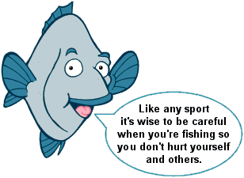
Remember

Slide 19
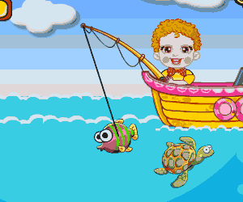


Good bye.

